Slide 1
Aero Engine Supplier Quality Group (AESQ) Overview
ASQR-01 Rev 13
P&W Paragraph 2 Changes

Slide 2
ASQR-01 Rev 12 to Rev 13 Changes
ASQR-01 Rev 12 was published in May 2022 and the result of some very last-minute efforts.
Small additions were needed to P&W Chapter 2 of ASQR-01 Rev 12
“Error” in AS13100 needs clarification relating to P&W approval of significant changes
Part marking text from ASQR-01 Rev 11 missed
Clarification of Certification requirements for Special Process Suppliers
Clarification of the relationship between AS13100 and the Reference Material documents (based on supplier feedback)
Clarification of the applicability of Section 18 of AS13100 to P&W
ASQR-01 Rev 13 was published in November 2022 with an effective date of 1/1/2023

Slide 3
ASQR-01 Rev 13
Issue: AS13100 section 4.3.1 has the requirement below:
And “significant changes” is defined in AS13100 as:
ASQR-01 Rev 13 to include the following:
4.3.1 Determining the scope of Quality Management System – Supplemental Requirements
The wording of Section 4.3.1 paragraph 3 is replaced by, “The customer shall be notified in a timely manner of any significant changes per the notification requirements of AS13100 and this document.”

Slide 4
ASQR-01 Rev 13
Issue: FAI part marking requirement from ASQR-01 Rev 11 was missed and an additional clarification will be added.
Current Rev 13 proposed text:
8.5.1.6 First Article Inspection (FAI) – Supplemental Requirements.
The following is added to bullet #4 (below):
Conduct an assessment, carried out by a competent person, to determine the required verification when changes occur that can invalidate a previous FAI. The assessment is to consider:
The impact of the change on the ability of the production method to meet product design characteristics.
Equipment and associated software programs, personnel, and environment.
The accumulation of changes covered by partial FAI or Dimensional/Non-dimensional Reports which may warrant a repeat full FAI being performed.
Part marking re-approval shall be required when process changes occur that may impact the accepted conditions on the original part marking approval. (new wording)
The following is added as new bullet #9:
Include a replication of product part marking (e.g., photograph or sample) that represents production marking within the FAI Report.
Note: To ensure correct part marking, approval can be obtained from P&W prior to FAI submission. (existing wording from Rev 11)

Slide 5
ASQR-01 Rev 13
Issue: Clarification of QMS certification requirements for Special Process Suppliers isn’t clear in the current Rev 12. The addition of the existing text from ASQR-01 Rev 11 (in red) below to be added to the current ASQR-01 Rev 12 section 4.3.5 allowing for either AS9100 or Nadcap certification for Special Process Suppliers.
4.3.5 Table 2 QMS Certification Requirements
Organizations receiving a purchase order from P&W and their Suppliers shall be compliant to the requirements of AS13100 Table 2.
Exceptions to the above are the following:
Type 1: Make to Print and Type 2A: Design and Manufacture Suppliers shall only need to be compliant to 9100, not registered.
Type 3 Distributors shall be certified to AS/EN/JISQ 9120, AS/EN/JISQ 9100, ISO 9001, or IATF16949:2016.
Type 4: Special Process Suppliers shall be certified to AS/EN/JISQ 9100 or Nadcap AC7004.
Distributors of metals, electronics, and hardware in the supply chain shall be on the RTX QDL.
Distributors not on the RTX QDL (to include lower-tier suppliers) shall use ASQR-01 Form 9 to request and obtain approval prior to delivering parts to Organizations and/or P&W.

Slide 6
ASQR-01 Rev 13
Issue: Some suppliers have questioned the use of the AS13100 Reference Material (RM) documents in support of “shall” requirements in AS13100. In order to be 100% clear, the following text will be added to section 4.
4. QUALITY MANAGEMENT SYSTEM (QMS)
Organizations receiving a purchase order from P&W shall comply with the requirements of AS13100 and ASQR-01 Chapter 2. The following P&W company-specific requirements are aligned to the numbering scheme of AS9100 and AS13100.
Note: Where Reference Material documents (e.g., RM13004, RM13145) are referred to in AS13100, the contents of those Reference Material documents are not to be interpreted as establishing additional requirements to AS13100.

Slide 7
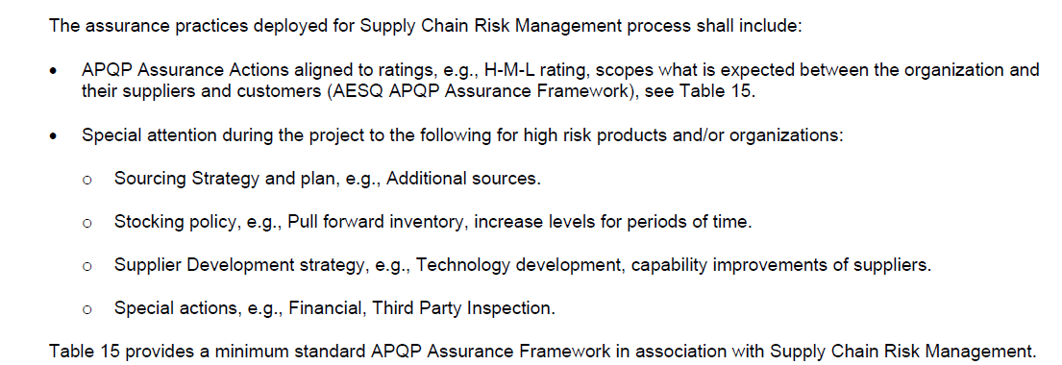
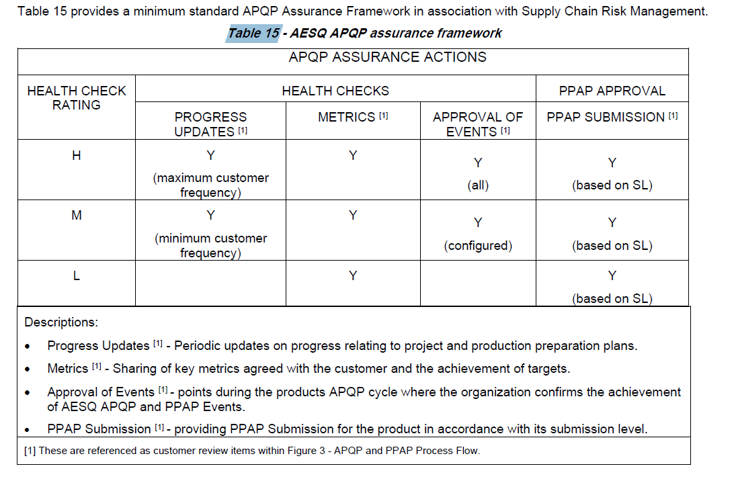
ASQR-01 Rev 13
Issue: Section 18 on APQP Supply Chain Risk Management Process is not in line with current P&W requirements/expectations
The following text is to be added to ASQR-01 Rev 13:
18. AESQ SUPPLY CHAIN RISK MANAGEMENT PROCESS - SUPPLEMENTAL REQUIREMENTS
The requirements of Section 18. are presented as a best practice and not mandatory deliverables for P&W.

